Slide 1
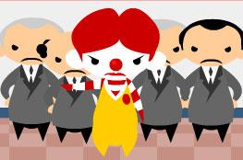
New Fast Food Trend
Sara To (23)
Kathryn Yung (30)
F.6Arts

Slide 2







What’s your choice for lunch?
What do you prefer?
Set A
Set B
BIGMAC, French Fries and Coke – McDonald’s
Fried Chicken – KFC
Pizza – Pizza Box
Salad
Sandwich
Fruits and Juice

Slide 3
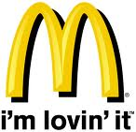
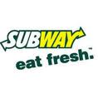
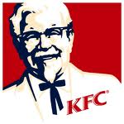
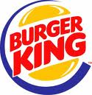

Current situation
Hong Kong’s fast pace of life → demand for fast food

Slide 4
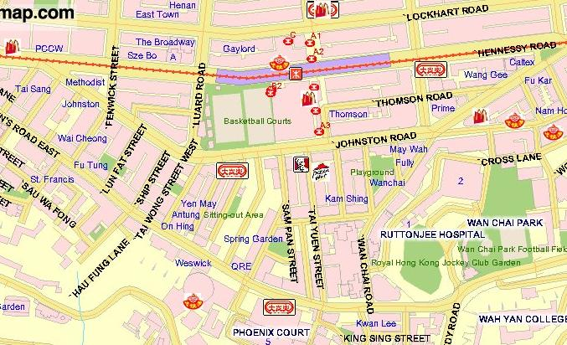
13 fast food shops can be found in such a small area in Wan Chai!!
Hong Kong has the highest percentage (61%)of fast-food addicts in the world.

Slide 5
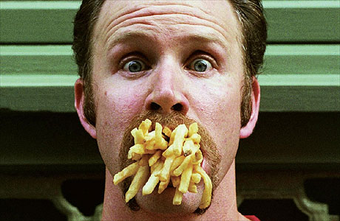
In the movie of “Super Size Me”
Mr. Spurlock ate McDonald’s burgers and French fries for 30 days
After 20 days, doctors advice him to stop the experiment, because his life was in danger
http://www.youtube.com/watch?v=0gWjCZ1xv8s&feature=related
→traditional fast food creates health threat

Slide 6
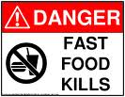
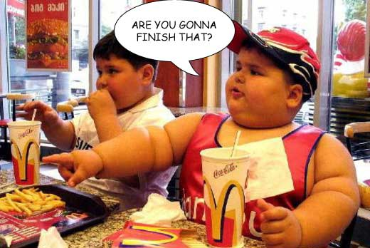
Negative impacts of traditional fast food
lack of nutrients
contains high calories
health problem
(e.g. heart disease, high blood pressure, high cholesterol)

Slide 7




Interesting Fact
560 calories
Big Macs in Hong Kong contain more fat and cholesterol .
480 Calories 493 Calories 500 Calories

Slide 8


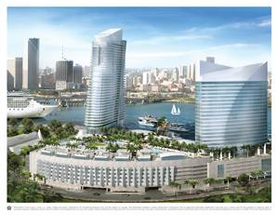
Emergence of fast-service food shops in HK
Influence of mass media
Rising trend of “Thin Is In”
Improvement in living standard
Change in eating habits
(more health conscious)
→emergence of Triple O’s–White Spot,
fast-service food shop

Slide 9
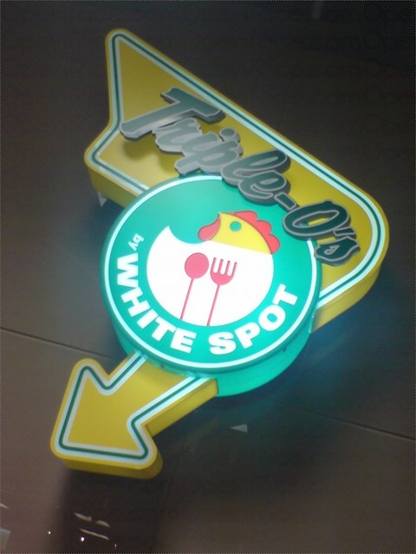
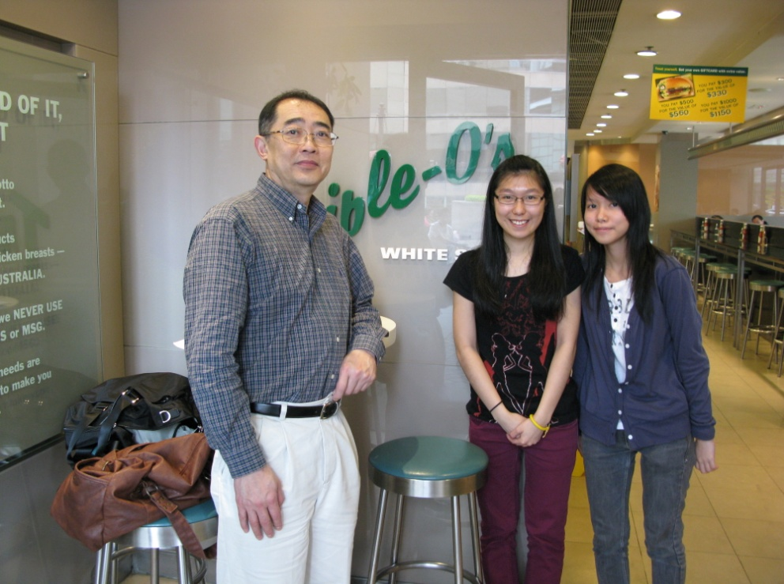
Interview with Mr. Victor Chan
(managing director of the Triple O’s, Hong Kong franchise)
Aims: provide high quality, home-made and healthy fast food and family-friendly services

Slide 10
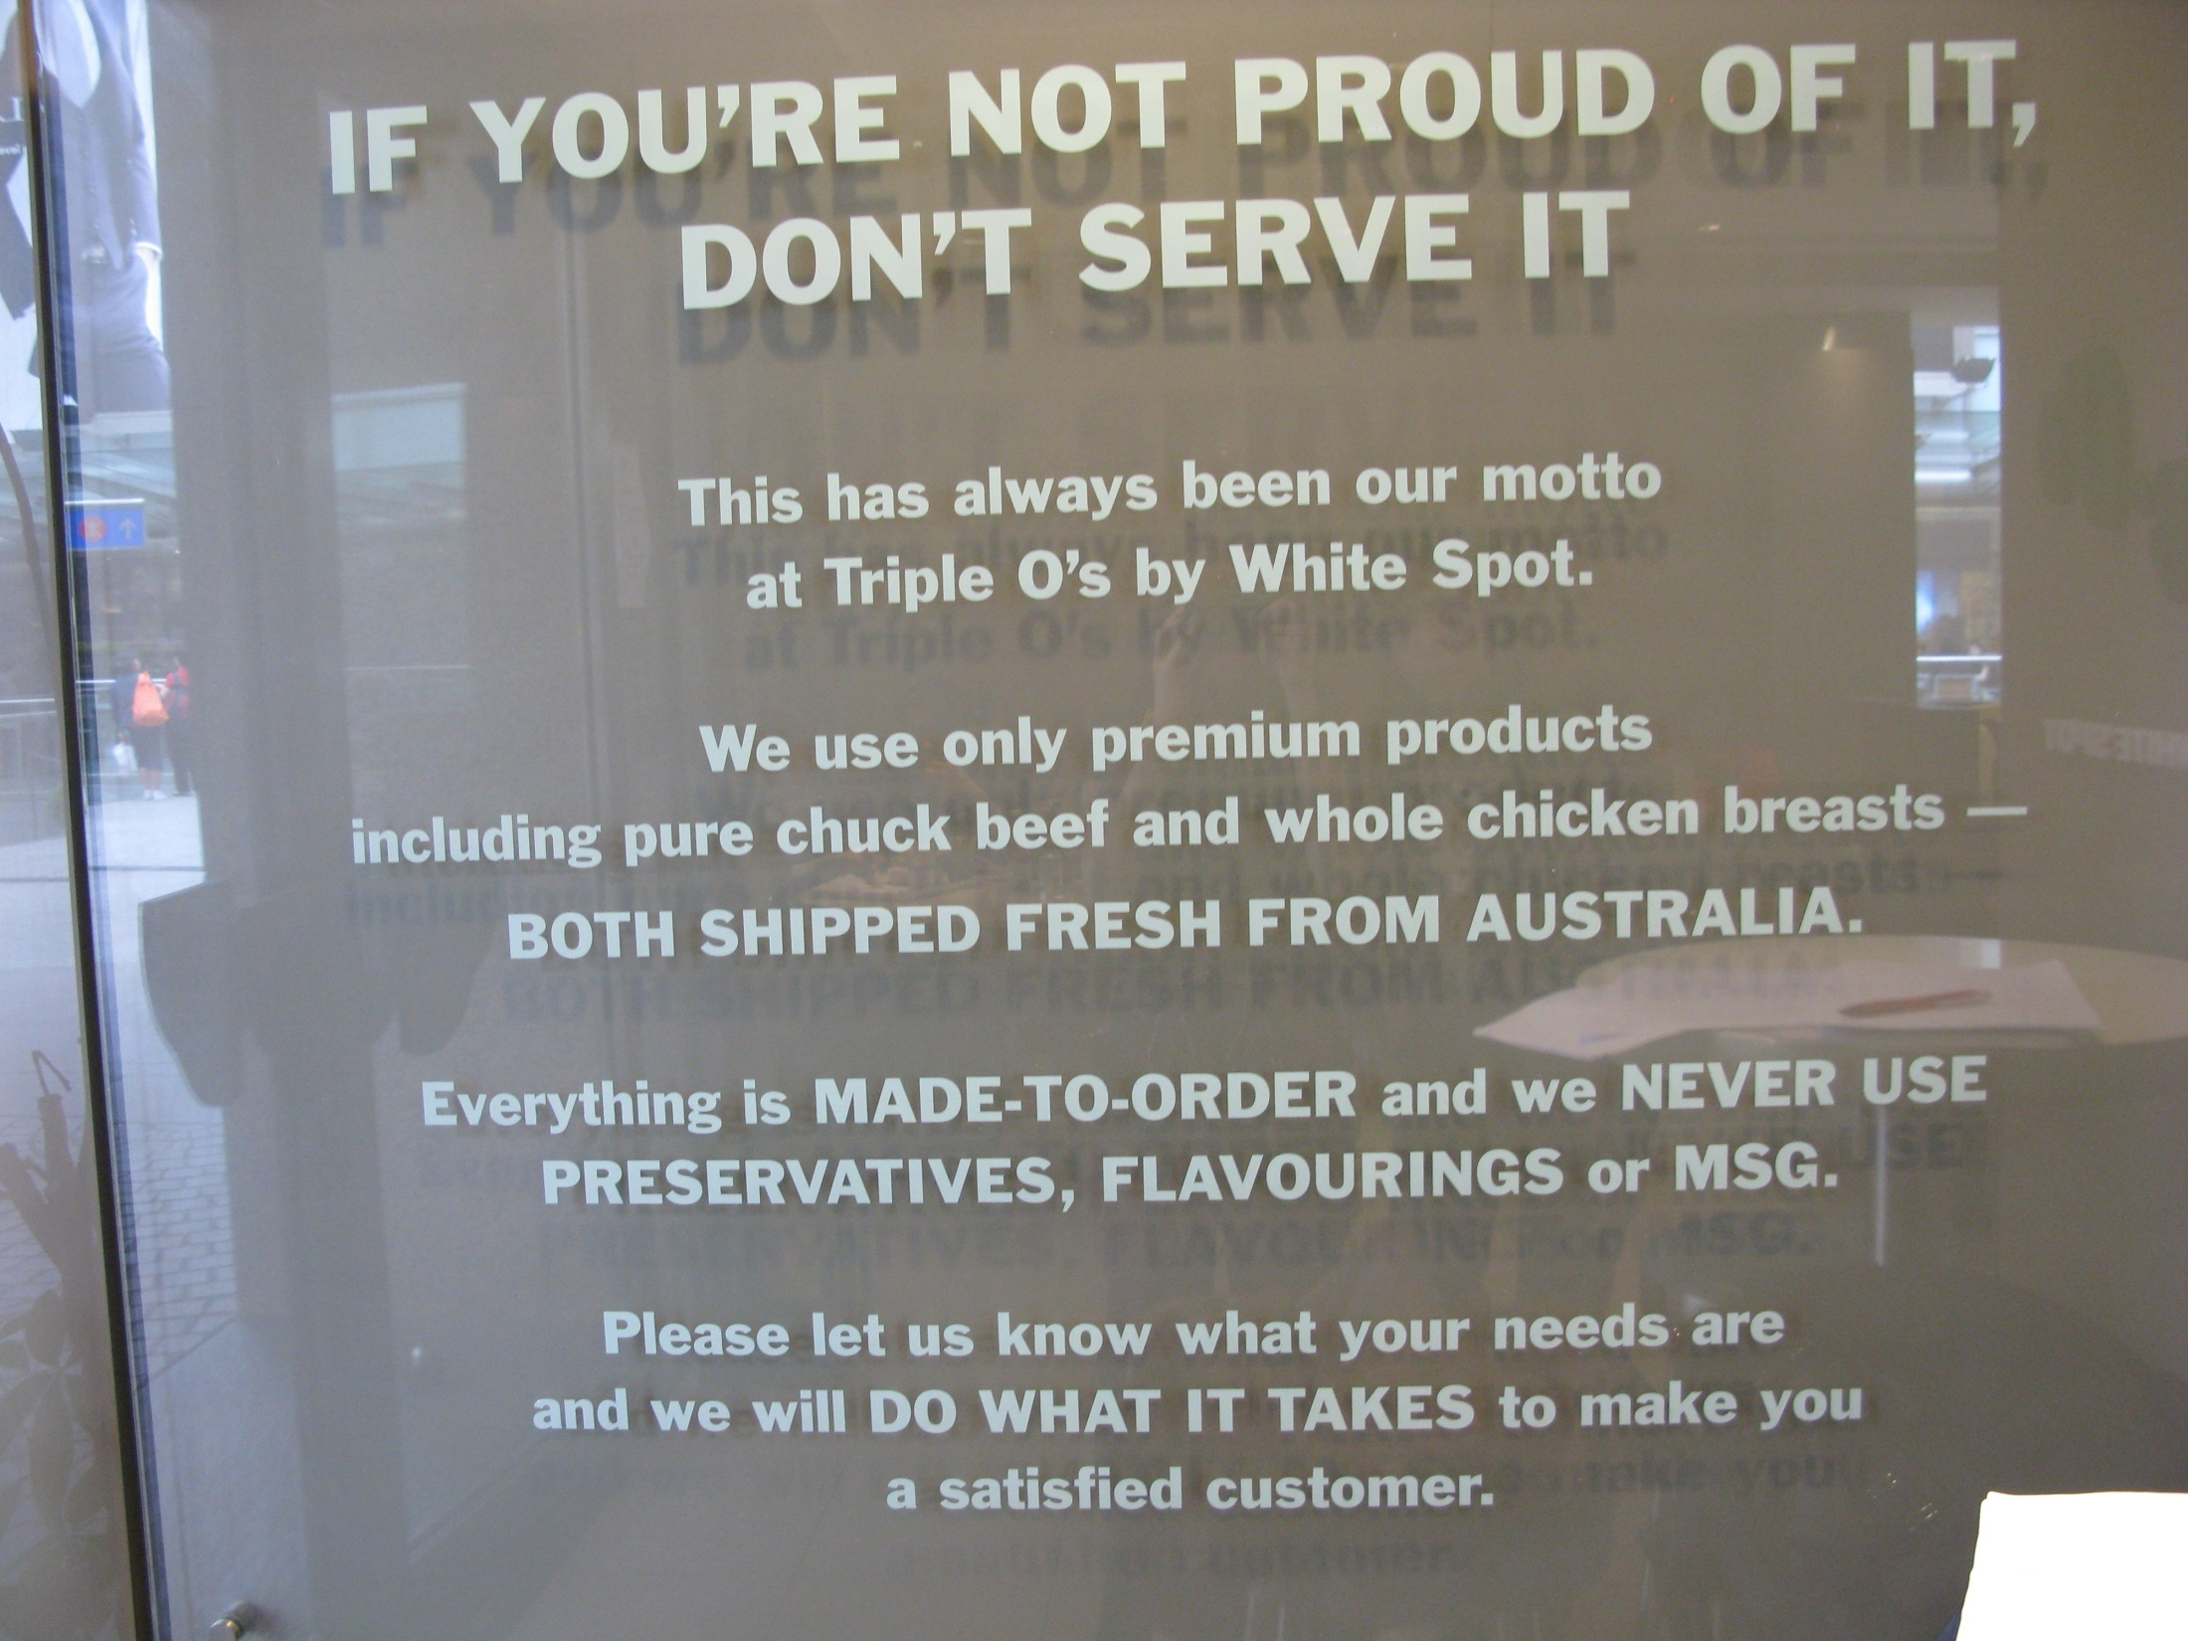

Slide 11
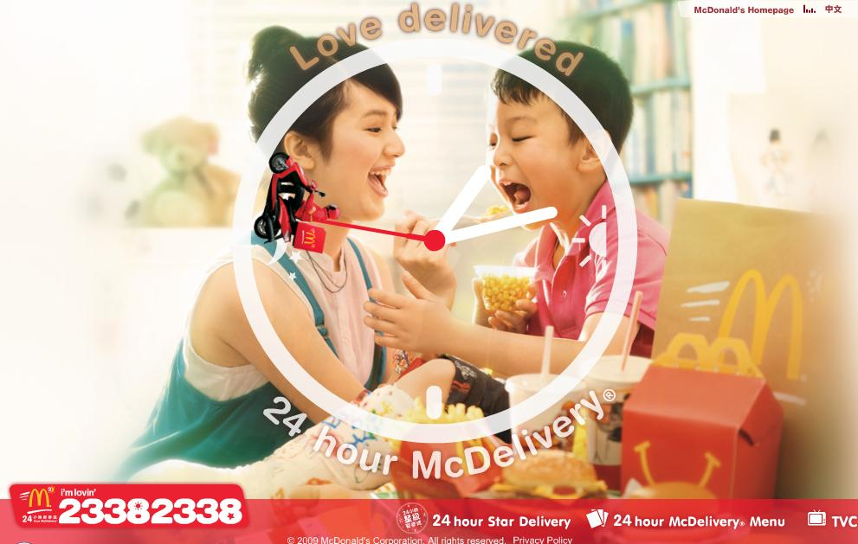
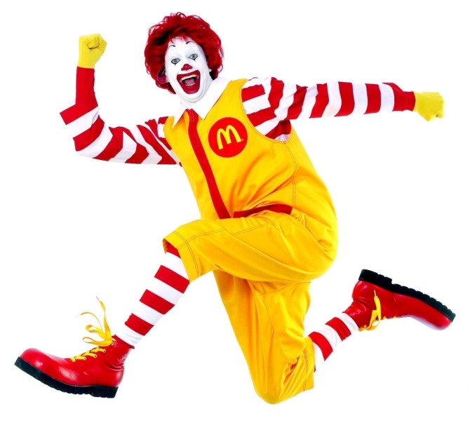
Traditional fast food
- Focus in minimizing the production cost
Low quality food
Unhealthy cooking method
Less services
More advertisement

Slide 12
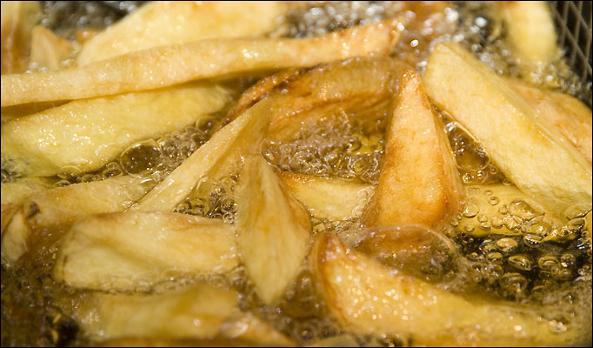
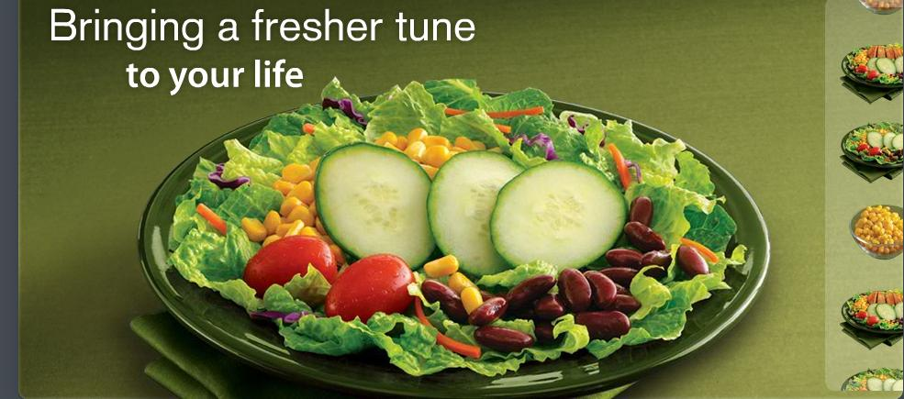
Influence of fast-service food shops
Traditional fast food shops realize the need of change
->provide immediate and healthier foods

Slide 13
Conclusion
Fast food culture in Hong Kong has changed
The emergence of the brand-new fast food trend brings positive impacts to both the catering industry and customers.
New dining experience
Market of healthier fast food

Slide 14
THE END
Thank you ☺

