Slide 1
JUPAS Application
2 Oct, 2018

Slide 2
Information Day 2018
HKUST | 29/9 (Sat) | 09:00 – 18:00
Poly U | 6/10 (Sat) | 09:30 – 18:00
HKBU | 13/10 (Sat) | 09:30 – 17:00
CU | 20/10 (Sat) | 09:00 – 17:00
EdUHK | 27/10 (Sat) | 09:00 – 17:00
HKU | 3/11 (Sat) | 09:00 – 18:00

Slide 3
University Grants Committee (UGC)-funded Programmes
City University of Hong Kong (CityU)
Hong Kong Baptist University (HKBU)
Lingnan University (LingnanU)
The Chinese University of Hong Kong (CUHK)
The Education University of Hong Kong (EdUHK)
The Hong Kong Polytechnic University (PolyU)
The Hong Kong University of Science and Technology (HKUST)
The University of Hong Kong (HKU)
Associate degree programmes
Higher diploma programmes
Higher diploma programmes

Slide 4
Self-financing Programmes
The Open University of Hong Kong (OUHK)

Slide 5
Study Subsidy Scheme for Designated Professions / Sectors (SSSDP) Programmes 指定專業／界別課程資助計劃
Offer full-time bachelor's degree programmes
Institutions include
Caritas Institute of Higher Education (CIHE) 明愛
Chu Hai College of Higher Education (CHC) 珠海
Hang Seng Management College (HSMC) 恒管
The Open University of Hong Kong (OUHK) 公大
Tung Wah College (TWC) 東華
Technological and Higher Education Institute of Hong Kong, Vocational Training Council (VTC - THEi) 職訓

Slide 7
$ 41 700
$ 72 800

Slide 10
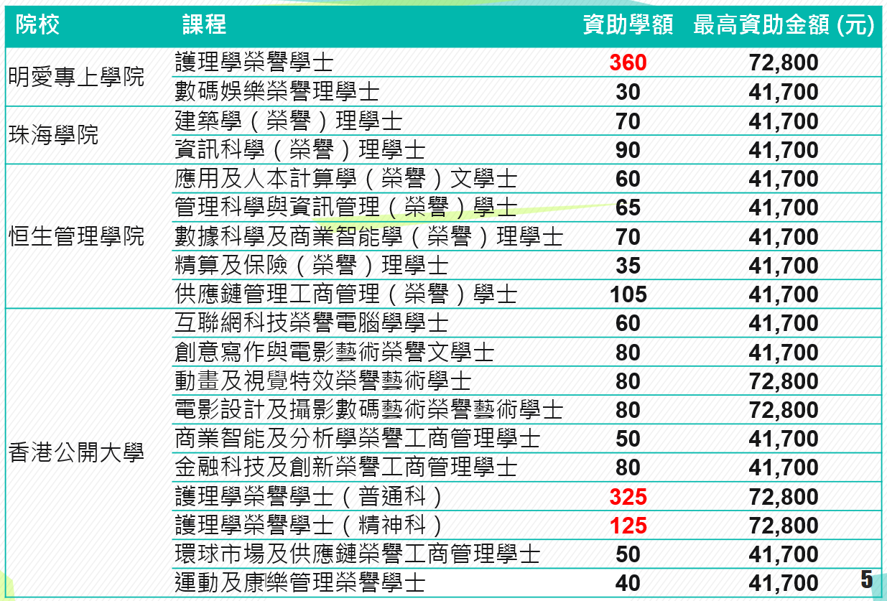

Slide 11
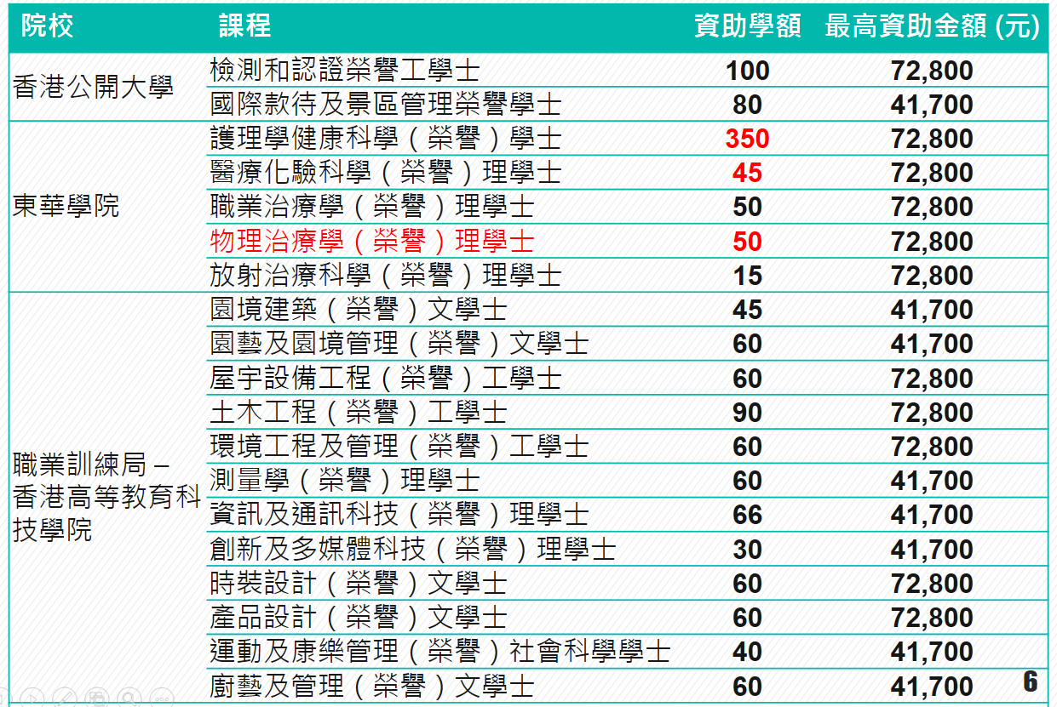

Slide 13
Apply through JUPAS
Full time Bachelor’s degree programmes
(UGC-funded, Self-financing, SSSDP)
UGC funded full time Sub-degree programmes (AD, HD)

Slide 14
Create JUPAS Account
8/10 (1:40 pm) | 6D | Computer Room (LG1)
9/10 (1:40 pm) | 6C
10/10 (1:40 pm) | 6B
12/10 (1:40 pm) | 6A

Slide 15
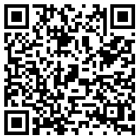
Application fee $460
Credit Card
PPS
E-banking (HSBC, Hang Seng, The Bank of East Asia)
Pay cash to JUPAS account at any branch of The Bank
of East Asia
Pay cash at JUPAS Office (Knowles Bld, HKU)
http://www.jupas.edu.hk/en/application-procedures-information/application-procedures/application-fee/
your JUPAS account will only be activated after the payment is made

Slide 16
Iteration Process
Institution
Merit order list
Applicant
Order of preference
One single offer / No offer

Slide 17
Iteration Process https://www.jupas.edu.hk/en/page/detail/648/

Slide 18
Strategy:
List the 20 study programmes honestly in the descending order of preference
Check past entrance statistics, admission quota, offer statistics…..
Decide Band A and Band B choices carefully
(advise to put those with interview arrangement before the release of HKDSE results to band A and B)

Slide 19
1. Application procedures:
Prepare 20 programme choices
Note:
You can add / drop 5 programmes after the release of HKDSE results

Slide 20
Check general entrance requirements
and individual programme requirements
Check offer statistics
Check past statistics
JUPAS website
HKACMGM
VISIT the JUPAS website under "Programme Changes" for updated information

Slide 24
JUPAS Website: www.jupas.edu.hk
Check additional requirements of the programme
JUPAS web →choose institution → List of programmes → choose programmes

Slide 25
CU JS4903 Bachelor of Laws

Slide 26
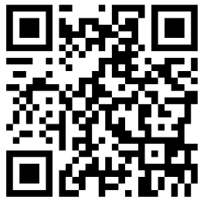
Check past entrance statistics
JUPAS web → Useful Material

Slide 27
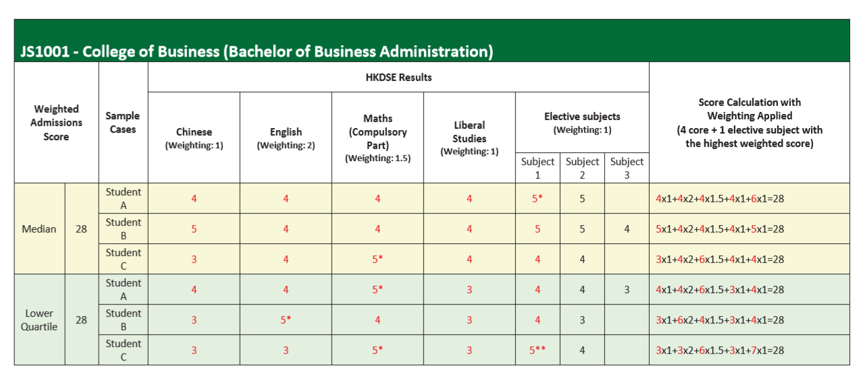
CityU

Slide 28
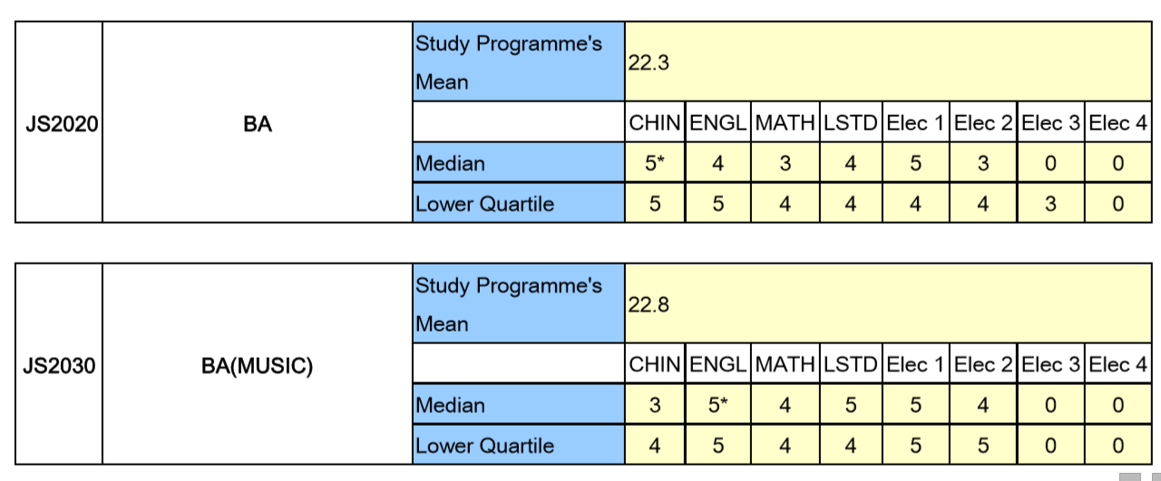
HKBU

Slide 29
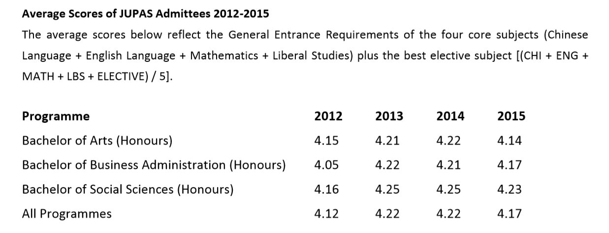
LingnanU

Slide 30
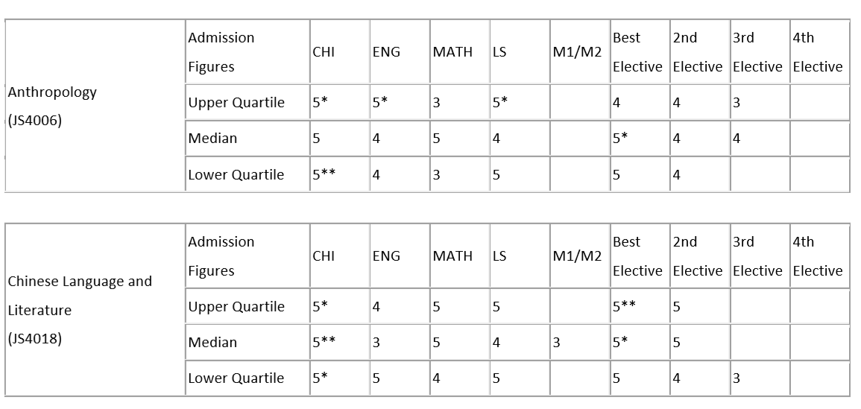
CUHK

Slide 31
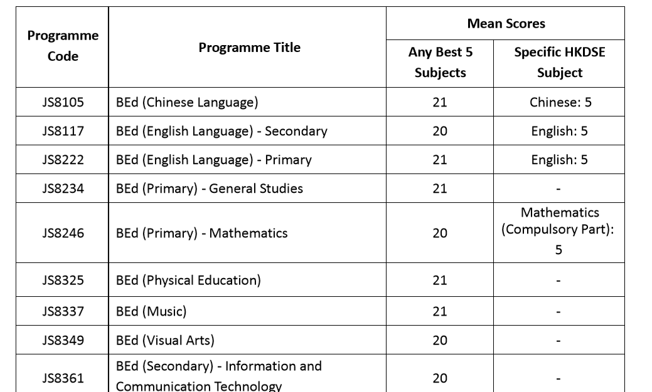
EdUHK

Slide 32
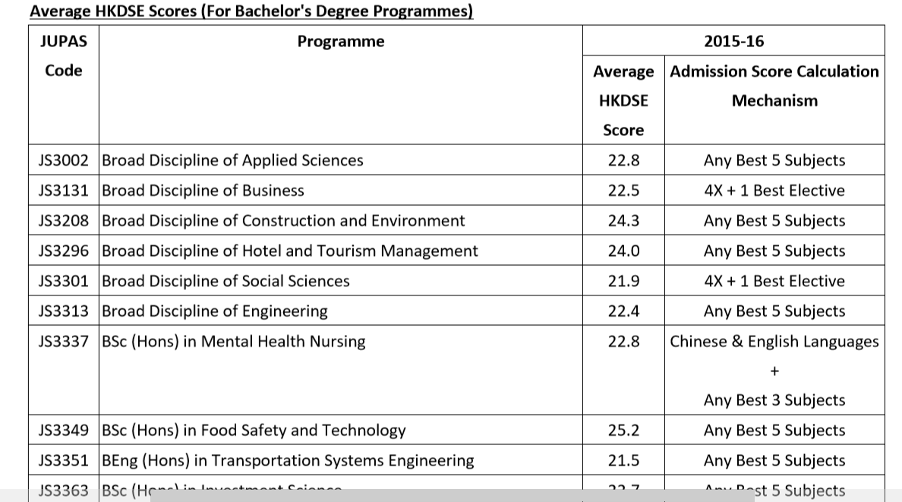
PolyU

Slide 33
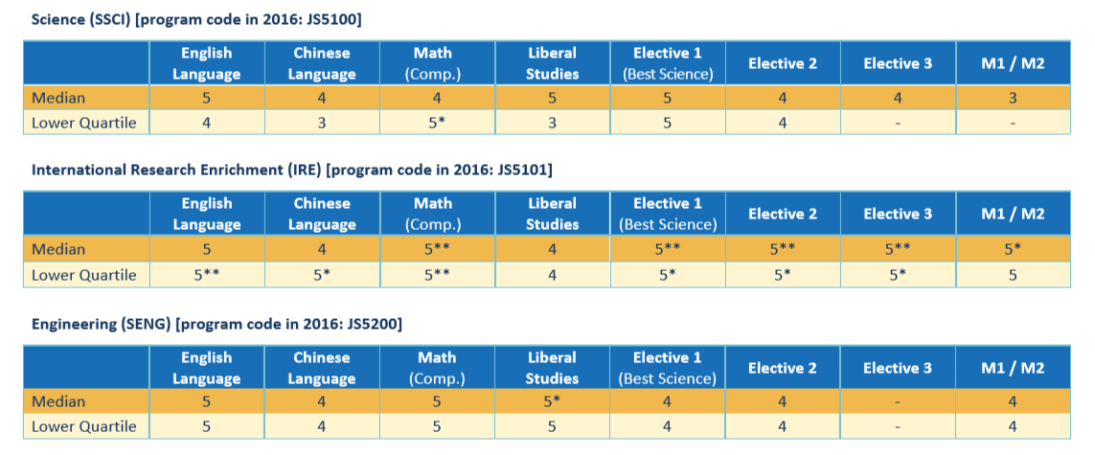
HKUST

Slide 34
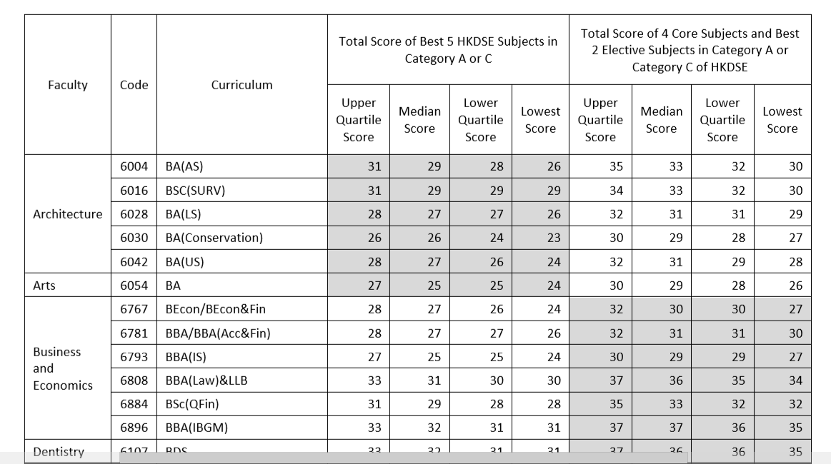
HKU

Slide 35
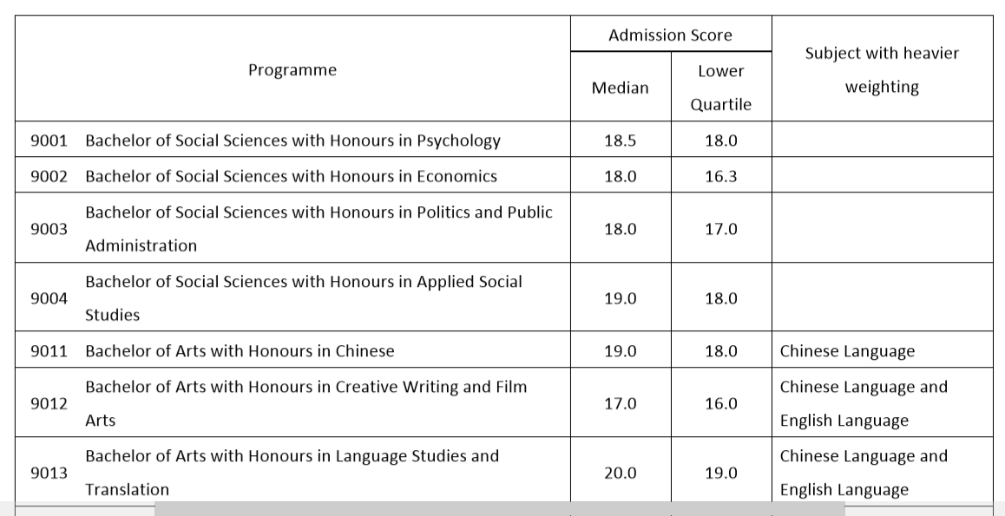
OU

Slide 36
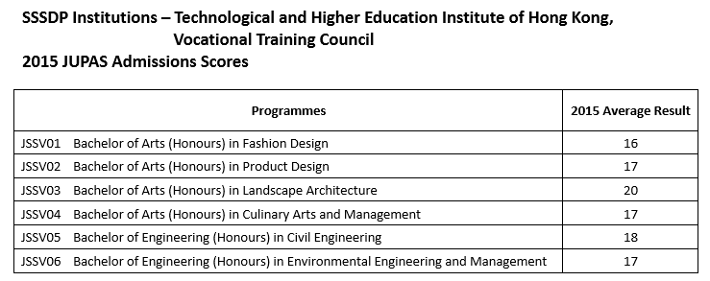

Slide 37
Check the details about interview arrangement
JUPAS web → choose institution → click interview arrangement

Slide 38
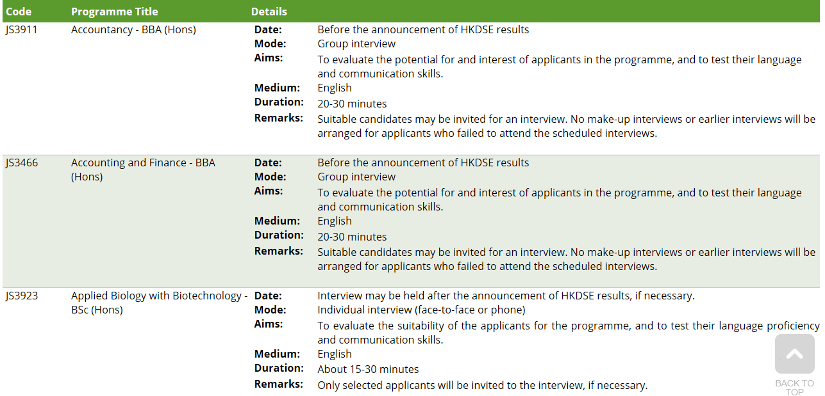
Poly U Interview Arrangement

Slide 40
Submit draft of Choice of Study Programmes to Careers teachers | On or before 1/11
Confirm and submit the following to JUPAS online system: Personal data 20 Choices of Study Programmes | On or before 26/11

Slide 41
2. Application procedures:
OEA (Other Experiences and Achievements )
Additional Information
Awards / Activities
Such information will serve as important additional reference for admission selection and can also be used as a framework for discussions during selection interviews

Slide 42
OEA - Additional Information
aims at allowing the applicants to describe an interest or activity that has been particularly meaningful to them or has affected their personal growth and life goals
Word limit : 300 - 500 words in English

Slide 43
OEA – Awards / Activities
The maximum number of
OEA items allowed is 10
JUPAS will randomly select and
request for supporting documents
Selected OEA awards / activities,
of which the supporting documents
are required, will be highlighted in
pink.

Slide 44
Submit draft of Additional Information to Form teacher and English subject teacher | On or before 12/11 (to FT) On or before 10/12 (to Eng. subject teacher)
Submit draft of Awards / Activities Information to Form teacher | On or before 17/12
Confirm and submit OEA Information to JUPAS Awards/ Activities Additional Information | On or before 4/1

Slide 45
3. Application procedures:
Verification of Academic /Music Qualifications
Details MUST be entered by applicants in their
JUPAS account before verification
put the original copies of the certificates inside a clear folder with your name, class and class number written on the cover of the folder

Slide 46
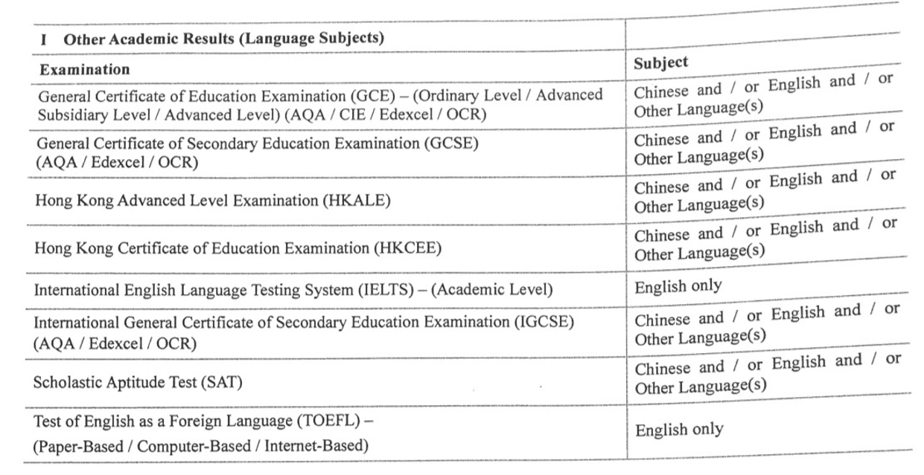

Slide 47
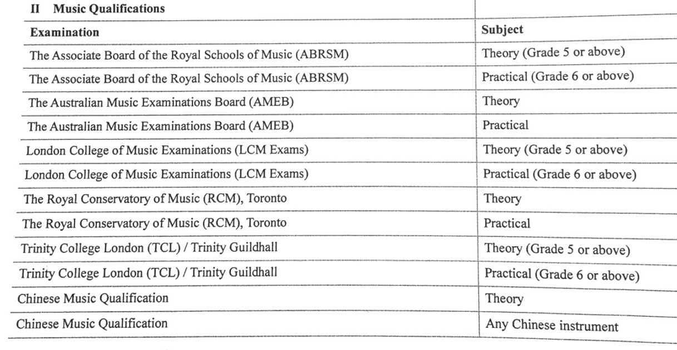

Slide 48
Submit the original certificates to school for verification (if any) | On or before 21/1

Slide 49
3. Application procedures:
SLP (Student Learning Profile)
Applicants can upload their SLP (in PDF format with a maximum file size of 3MB) to their JUPAS accounts
Complete and submit On or before 26/4

Slide 50
Non-JUPAS Courses
Self-financing
Degree programmes
Associate degree programmes
Higher diploma programmes
Apply through E-App in Dec

